Slide 1

Programming Two (csc7051)
Aidan McGowan
More exceptions – a closer look

Slide 2
Introduction
Recall an exception is an indication of a problem that occurs during a program’s execution.
Exception handling enables you to create applications that can resolve (or handle) exceptions.
In many cases, handling an exception allows a program to continue executing as if no significant problem has been encountered.

Slide 3
Recall - Try and Catch
If an exception occurs in a try block (such as an InputMismatchException) the try block terminates immediately and program control transfers to the first of the following catch blocks in which the exception parameter’s type matches the thrown exception’s type.
An uncaught exception is one for which there are no matching catch blocks and may result in program termination.

Slide 4

Flow…
After the exception is handled, program control does not return to the throw point, because the try block has expired (and its local variables have been lost). Rather, control resumes after the last catch block. This is known as the termination model of exception handling.
Good Programming Practice
Using an exception-parameter name that reflects the parameter’s type promotes clarity by reminding you of the type of exception being handled.

Slide 5
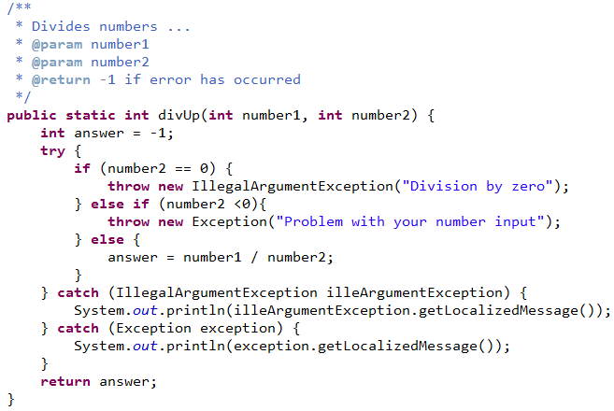
Block and Statement
The try block and its corresponding catch and/or finally blocks form a try statement.
Do not confuse the terms “try block” and “try statement”—the latter includes the try block as well as the following catch blocks and/or finally block.
Try block
Try statement

Slide 6
Variable scope
As with any other block of code, when a try block terminates, local variables declared in the block go out of scope and are no longer accessible; thus, the local variables of a try block are not accessible in the corresponding catch blocks.
When a catch block terminates, local variables declared within the catch block (including the exception parameter of that catch block) also go out of scope and are destroyed.

Slide 7
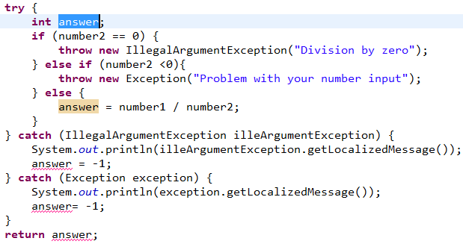
Scope of variables
out of scope

Slide 8
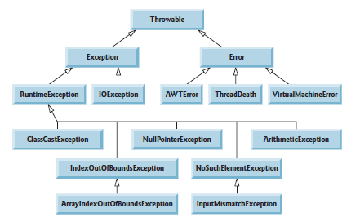
Throwable inheritance hierarchy

Slide 9
Checked vs. Unchecked Exceptions
This distinction is important, because the Java compiler enforces a catch-or-declare requirement for checked exceptions.
An exception’s type determines whether it’s checked or unchecked.

Slide 10
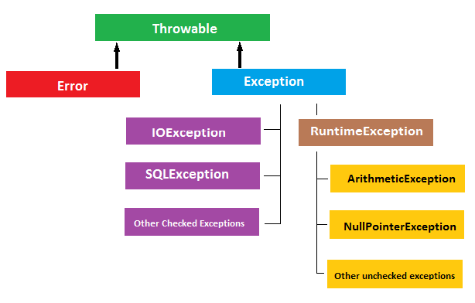
Checked vs. Unchecked Exceptions
All exception types that are direct or indirect subclasses of class RuntimeException (package java.lang) are unchecked exceptions.

Slide 11

Checked
Represent invalid conditions in areas outside the immediate control of the program (invalid user input, database problems, network outages, absent files)
Are subclasses of the exception class .
All classes that inherit from class Exception but not class RuntimeException are considered to be checked exceptions.

Slide 12
Checked
A method is obliged to establish a policy for all checked exceptions thrown by its implementation (either pass the checked exception further up the stack, or handle it somehow).
The compiler checks each method call and method declaration to determine whether the method throws checked exceptions. If so, the compiler verifies that the checked exception is caught or is declared in a throws clause.

Slide 13
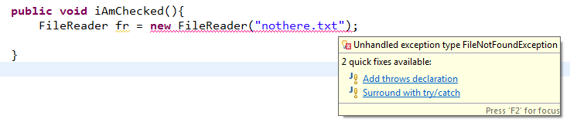
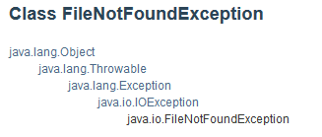
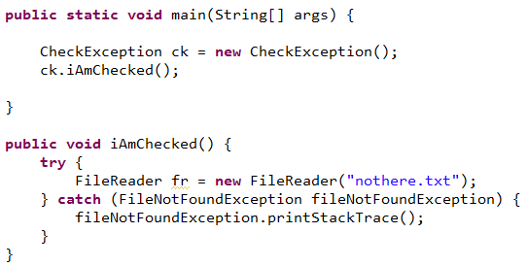
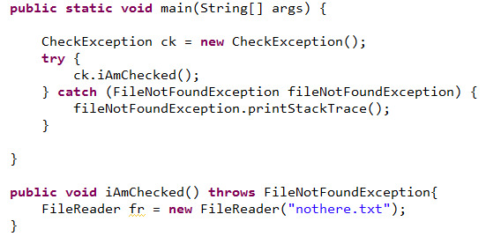
Checked exceptions - example

Slide 14

Unchecked Exceptions
Unlike checked exceptions, the Java compiler does not check the code to determine whether an unchecked exception is caught or declared.
Unchecked exceptions typically can be prevented by proper coding. For example, an unchecked DivisionByZeroException thrown by method can be avoided with validation before attempting to perform the division.

Slide 15
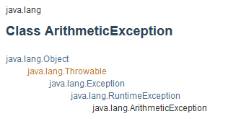
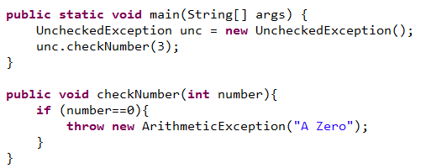
Unchecked Exception example
No requirement for the calling method to catch the potential exception.

Slide 16
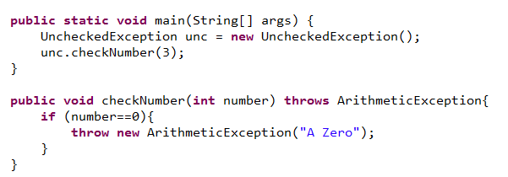
Unchecked Exception example
Unchecked exceptions are not required to be listed in a method’s throws clause—even if they are, it’s not required that such exceptions be caught by an application.

Slide 17
Obtaining Data from an Exception Object
Recall that exceptions derive from class Throwable. Class Throwable offers a printStackTrace() method that outputs to the standard error stream the stack
Often, this is helpful in testing and debugging. Class Throwable also provides a getStackTrace method that retrieves the stack-trace information that might be printed by printStackTrace.
Class Throwable’s getMessage method returns the descriptive string stored in an exception.

Slide 18
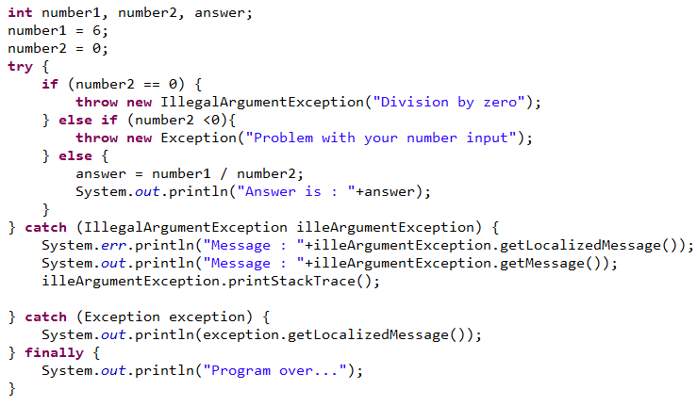
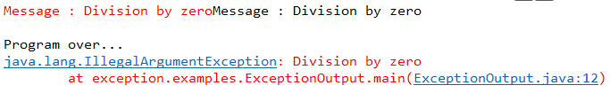
Exception information

Slide 19

Catching More Than One Type of Exception with One Exception Handler
In Java SE 7 and later, a single catch block can handle more than one type of exception. This feature can reduce code duplication and lessen the temptation to catch an overly broad exception.

Slide 20
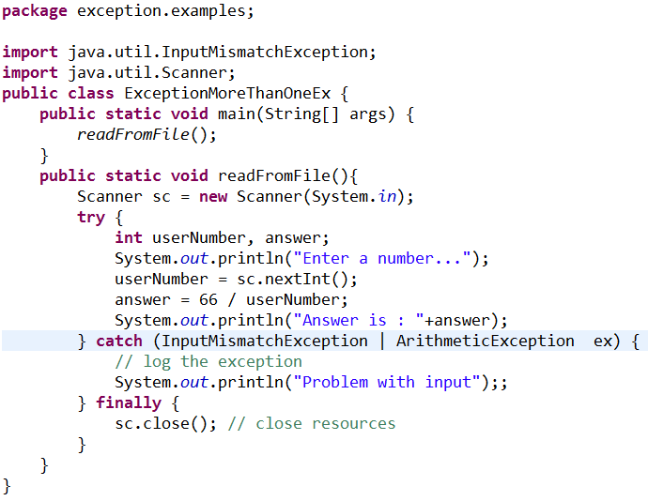
Catching More Than One Type of Exception with One Exception Handler

Slide 21
Finally block
The finally block is an ideal place to release resources acquired in a try block (such as opened files), which helps eliminate resource leaks.
Always release a resource explicitly and at the earliest possible moment at which it’s no longer needed. This makes resources available for reuse as early as possible, thus improving resource utilisation.

Slide 22
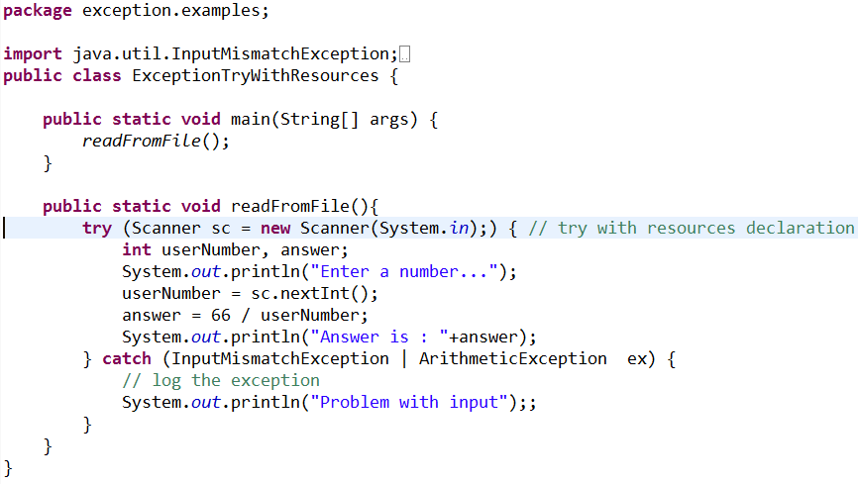
try-with-resources:
Automatic Resource Deallocation
The try-with-resources statement implicitly calls the Scanner’s close method at the end of the try block. You can allocate multiple resources in the parentheses following try by separating them with a semicolon (;). (You can use this with any Class that implements the AutoCloseable interface)

Slide 23

Using the throws Clause
This clause appears after the method’s parameter list and before the method’s body.
It specifies the exceptions the method throws.
Such exceptions may be thrown by statements in the method’s body or by methods called from the body. A method can throw exceptions of the classes listed in its throws clause or of their subclasses.
This indicates to the rest of the program that this method may throw the specified exception.

Slide 24
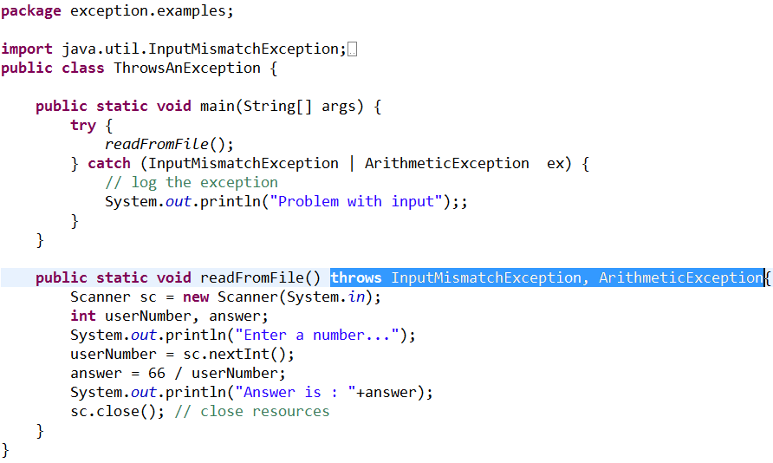
Using the throws Clause
If an exception of the type occurs it is thrown back to the calling method

Slide 25
Creating your own exceptions
Most Java programmers use existing classes from the Java API to build Java applications.
You write code that processes these existing exceptions to make your programs more robust.
It may also be useful to declare your own exception classes that are specific to the problems that can occur when another programmer uses your reusable classes.

Slide 26
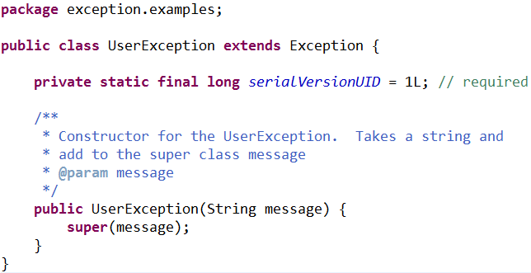
Creating your own exceptions
A new exception class must extend an existing exception class to ensure that the class can be used with the exception-handling mechanism.
Notes:
the root class for all exceptions, Throwable implements the Serializable interface. All exceptions by default are serializable and that's a language design decision because the authors wanted exceptions to be capable of being sent across the wire without any special configuration. If the base class is not serializable, you would have a difficult time conveying what exactly went wrong in case a remote method failed since you would have no control over the built in exception types.

Slide 27
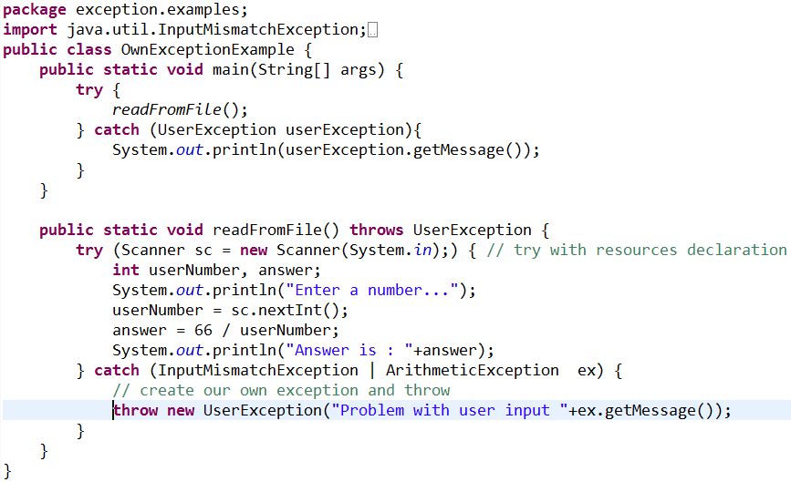


Creating your own exceptions

Slide 28
Rethrowing Exceptions
Exceptions are rethrown when a catch block, upon receiving an exception, decides either that it cannot process that exception or that it can only partially process it.
Rethrowing an exception defers the exception handling (or perhaps a portion of it) to another catch block associated with an outer try statement.

Slide 29
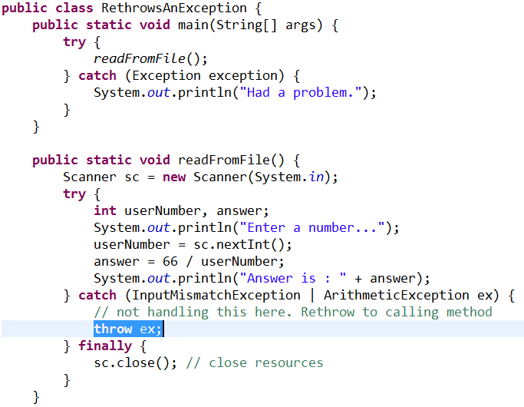
Rethrowing Exceptions

